Slide 1

UNIT TESTING WITH SPOCK
Rakhi Vishwakarma

Slide 2
What is Spock?
Testing framework
Written in Groovy
For Java and Groovy applications
Compatible with most IDEs and build tools

Slide 3
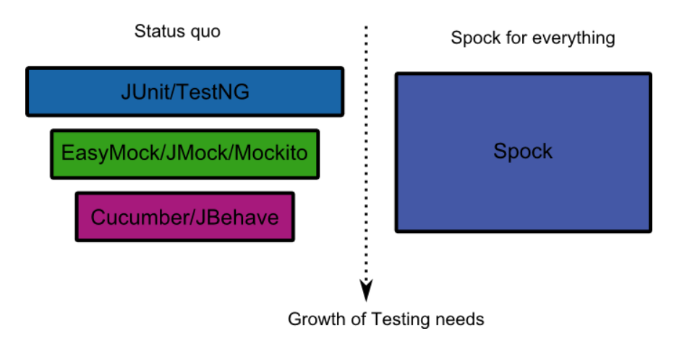
Why Spock ?
Created to cover the full testing lifecycle of a Java application
Comes with built-in mocking and stubbing and several extra testing annotations
BDD like test structure
Improved readability
Easier to get started with writing(good) test

Slide 4
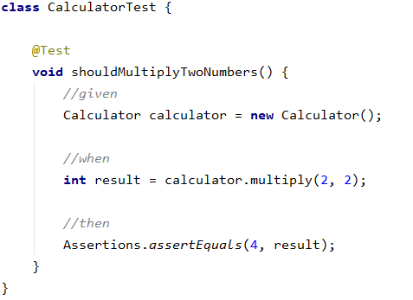
Test Structure
JUnit5 :

Slide 5
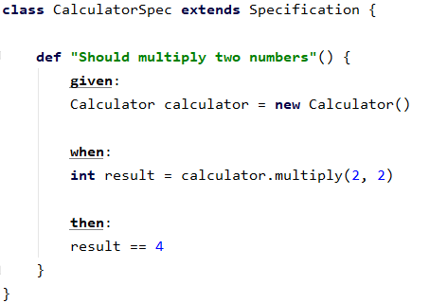
Test Structure
JUnit5 :
Spock :

Slide 6

Human readable titles
JUnit5 :

Slide 7
Human readable titles
JUnit5 : Spock :

Slide 8
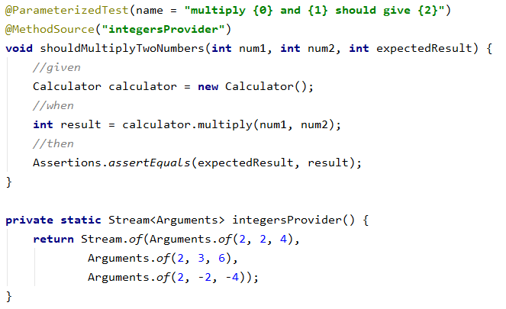
Parameterized Test
JUnit5 :

Slide 9
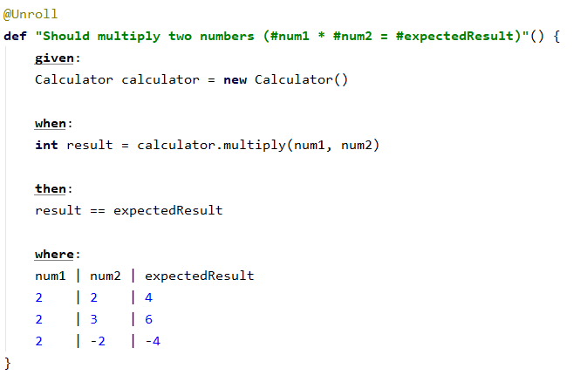
Parameterized Test
JUnit5 : Spock :

Slide 10

Failed test output
JUnit5 :

Slide 11
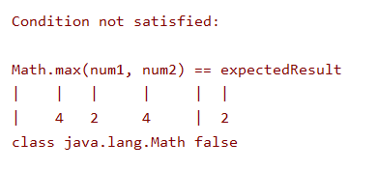
Failed test output
JUnit5 : Spock :

Slide 12

Exception Handling
JUnit5 :

Slide 13
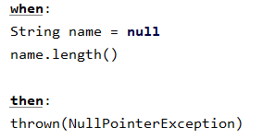
Exception Handling
JUnit5 : Spock :

Slide 14
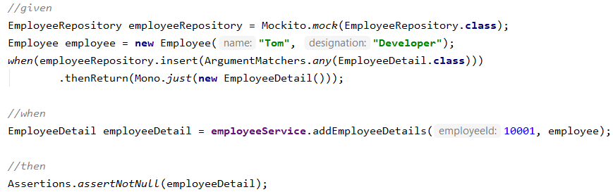
Mocking
JUnit5 :

Slide 15
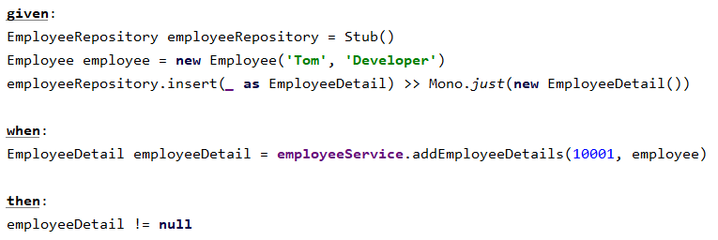
Mocking
JUnit5 : Spock :

Slide 16
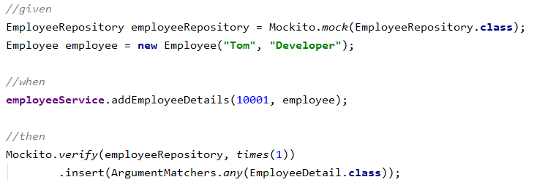
Interaction testing
JUnit5 :

Slide 17
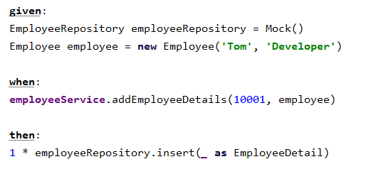
Interaction testing
JUnit5 : Spock :

Slide 18
Demo

Slide 19
Thank You!

